Slide 1



Customers and product insight
View in Power BI
Last data refresh:
3/15/2025 2:09:46 PM UTC
Downloaded at:
3/15/2025 2:27:09 PM UTC

Slide 2
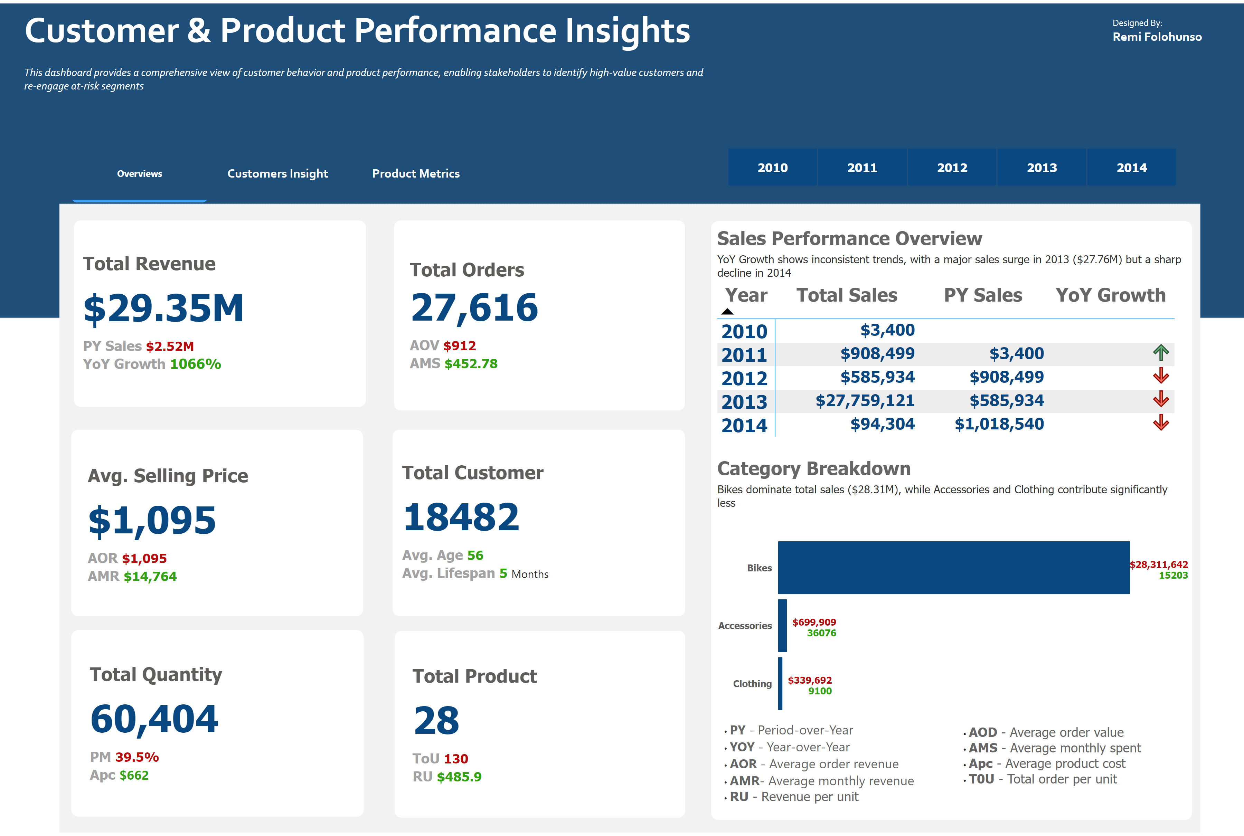
Overviews
Notes:
textbox
No alt text provided
textbox
No alt text provided
textbox
No alt text provided
cardVisual
No alt text provided
shape
No alt text provided
cardVisual
No alt text provided
shape
No alt text provided
cardVisual
No alt text provided
cardVisual
No alt text provided
shape
No alt text provided
cardVisual
No alt text provided
shape
No alt text provided
shape
No alt text provided
pageNavigator
No alt text provided
slicer
No alt text provided
cardVisual
No alt text provided
shape
No alt text provided
Sales Performance Overview
No alt text provided
Category Breakdown
No alt text provided
shape
No alt text provided
textbox
No alt text provided
textbox
No alt text provided

Slide 3
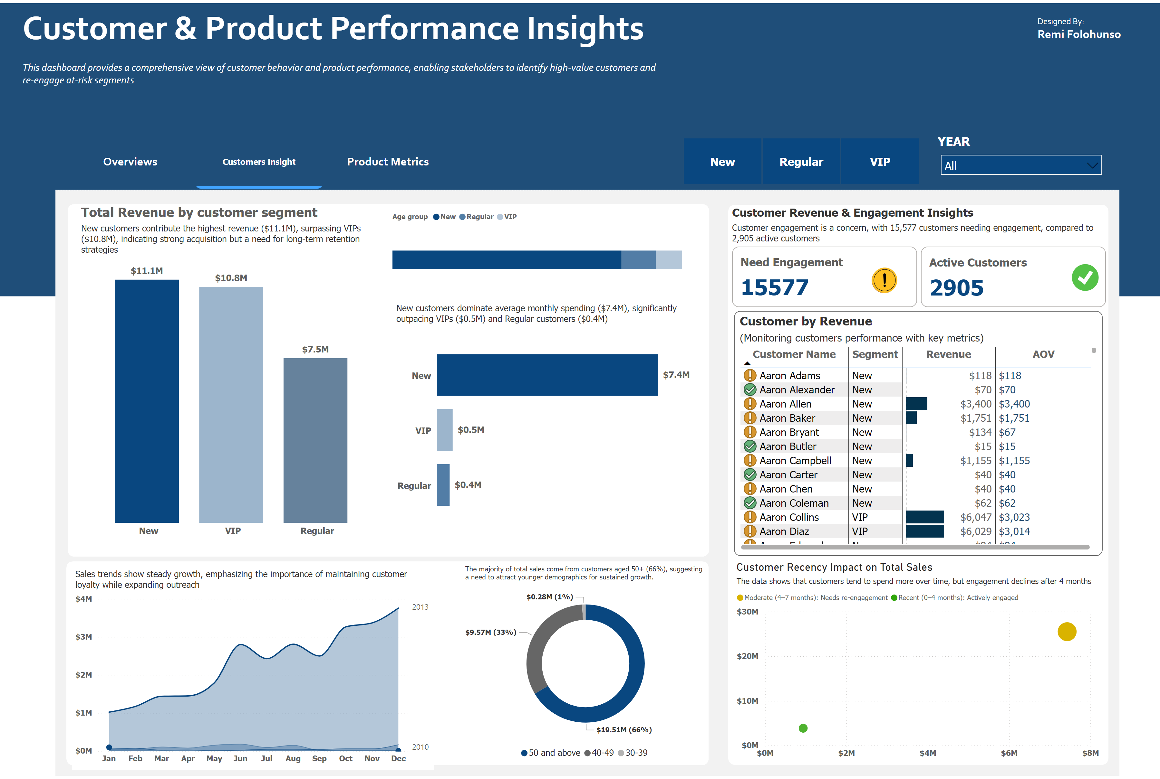
Customers Insight
Notes:
textbox
No alt text provided
textbox
No alt text provided
textbox
No alt text provided
Total Revenue by customer segment
No alt text provided
clusteredBarChart
New customers dominate average monthly spending ($7.4M), significantly outpacing VIPs ($0.5M) and Regular customers ($0.4M)
Customer by Revenue
No alt text provided
Customer Revenue & Engagement Insights
No alt text provided
Customer Recency Impact on Total Sales
No alt text provided
lineChart
No alt text provided
donutChart
No alt text provided
Total customer by Age group
No alt text provided
shape
No alt text provided
shape
No alt text provided
shape
No alt text provided
slicer
No alt text provided
pageNavigator
No alt text provided
YEAR
No alt text provided

Slide 4
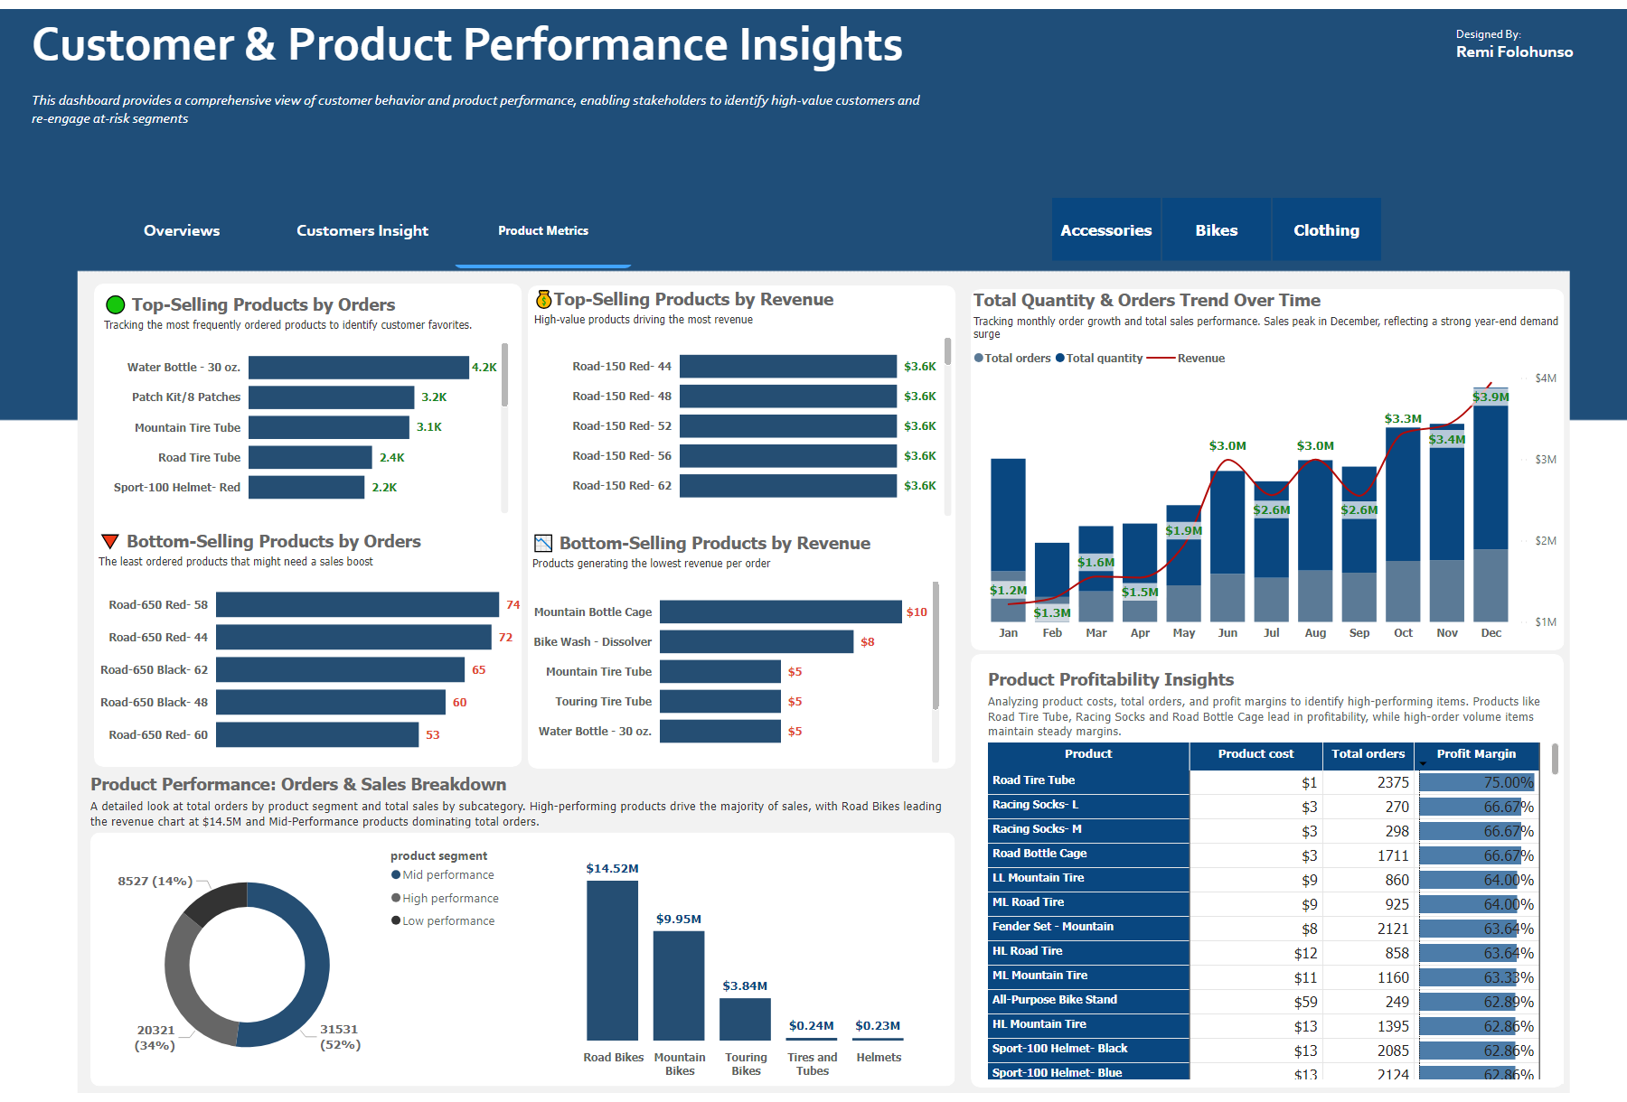
Product Metrics
Notes:
textbox
No alt text provided
textbox
No alt text provided
textbox
No alt text provided
🔻 Bottom-Selling Products by Orders
No alt text provided
🟢 Top-Selling Products by Orders
No alt text provided
💰Top-Selling Products by Revenue
No alt text provided
📉 Bottom-Selling Products by Revenue
No alt text provided
Total Quantity & Orders Trend Over Time
No alt text provided
Product Profitability Insights
No alt text provided
donutChart
No alt text provided
columnChart
No alt text provided
pageNavigator
No alt text provided
slicer
No alt text provided
shape
No alt text provided
shape
No alt text provided
Product Performance: Orders & Sales Breakdown
No alt text provided
shape
No alt text provided
Product Cost vs. Revenue Breakdown
No alt text provided

